Slide 1
Administrative Review Application for:
Kurtz Detached Garage
Board of adjustments presentation

Slide 2
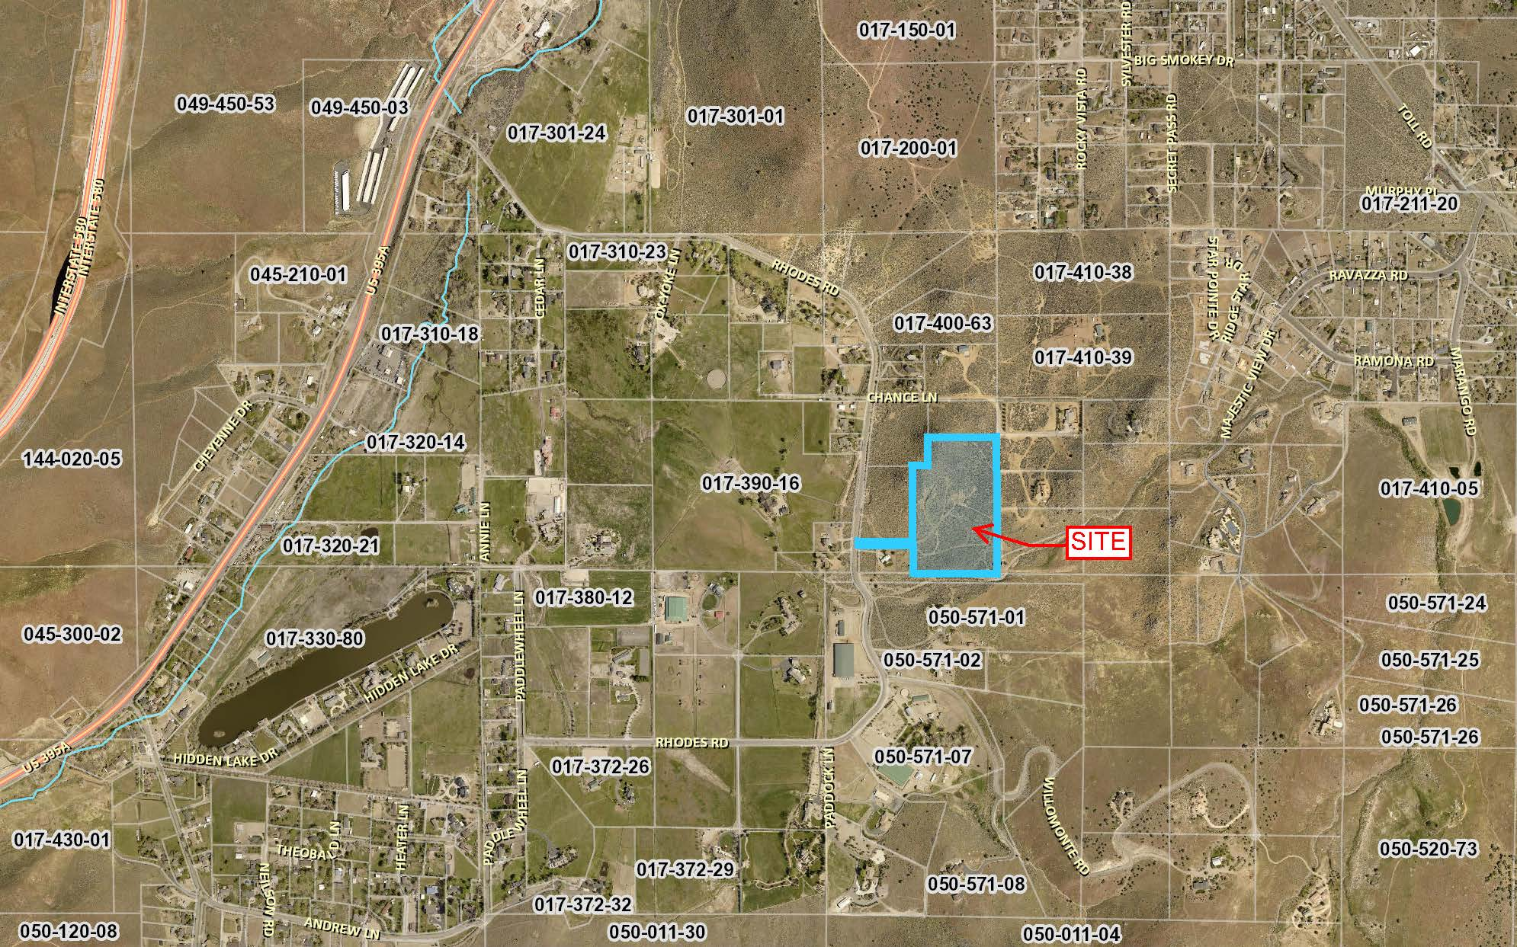
Vicinity Map

Slide 3
Project Description
The Administrative Review is required for a detached garage that is larger than the main structure.
Property Size = 653,400 S.F. (15 ac)
Zoning:
  MDR 33%, LDS 65%, GR 2%
Proposed Development:
  1,497 s.f. Residence
  6,000 s.f. Detached Garage
  A pad for a future residence

Slide 4
Proposed Improvements

Slide 5
Detached Garage Elevations

Slide 6
Detached Garage Elevations

Slide 7
Detached Garage Elevations

Slide 8
Detached Garage Elevations

Slide 9
Residence Elevations

Slide 10
Residence Elevations

Slide 11
Citizens Advisory Board Comments:
Does the project trigger a Major Grading Permit?
  No, the proposed improvements will not reach even half of the required thresholds for either disturbed area & earthwork volume.
Does the project impact or cross any other properties?
  No, all access will be from Rhodes Road.
Is the project in line with the neighborhood?
  Yes, there are multiple larger equestrian arenas in the immediate vicinity of the project.

Slide 12
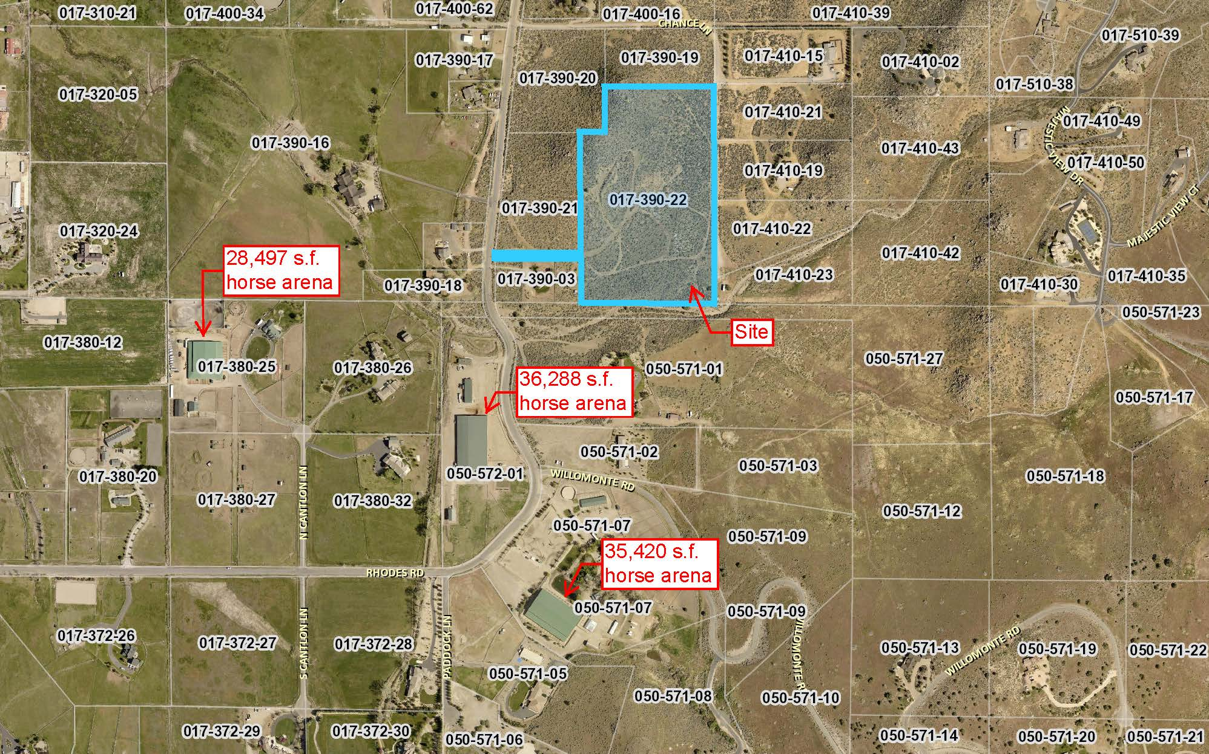
Surrounding Map

Slide 13
Thank You
We respectfully request the Board of Adjustments approve this application and are available for any questions you may have regarding the project.

